Slide 1
Alcohol

Slide 2
Lesson 1: The Health Risks of Alcohol Use
How does alcohol use contribute to risky behaviors?
Why do you believe that drinking alcohol is against the law below the age of 21?

Slide 3
Alcohol
Ethanol –
the type of alcohol in alcoholic beverages
Is a powerful and addictive drug
Can effect brain development
Fermentation
The chemical action of yeast on sugars
Alcohol can be produced naturally by fermenting fruits, vegetables, and grains

Slide 4
Alcohol that you drink moves into your stomach and into your small intestine. The alcohol then moves on into your bloodstream.
Alcohol will eventually reach your liver and breakdown into carbon dioxide and water. Each beer will take more than an hour to break down.
Alcohol is a depressant
Slows the central nervous system
Slows reaction time, impairs vision and diminishes judgment.

Slide 5
Intoxication
The state in which the body is poisoned by alcohol or another substance and the person’s physical and mental control is significantly reduced.
Blood Alcohol Level-
the amount of alcohol in a person’s bloodstream.
BAL can be influenced by body size, gender, food, rate of intake, amount, medicine
(can lead to illness or death)
One drink is enough to raise someone’s BAL to .025 or greater.
Drivers under 21 are considered legally intoxicated at a BAL of .02, an
adults at a BAL of .08

Slide 6
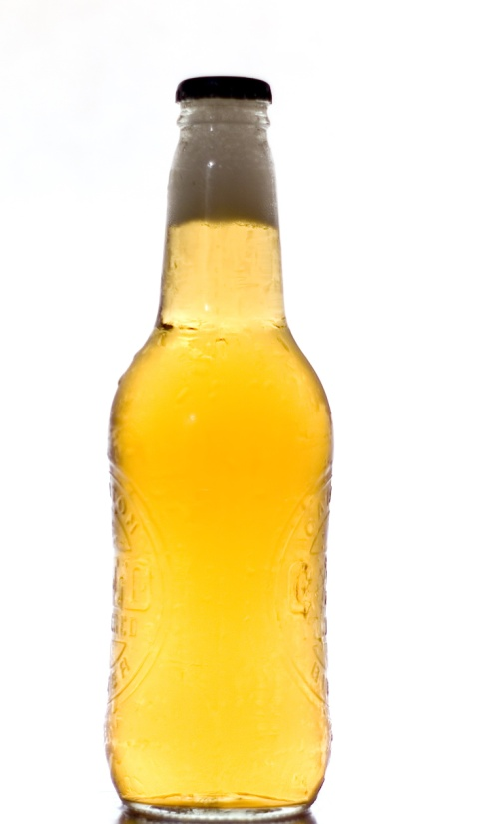
A 12 oz. bottle of beer, a 6 oz. of wine, and a 1.25 oz. glass of whiskey all have about the same alcohol content.

Slide 7
Short- Term Effects of Alcohol
Relaxed feeling
Face flush and warm
urinating frequently
Impaired vision and speech
Coordination are lessened
reflexes are impaired
Hangover- uncomfortable physical effects brought on by alcohol use. Symptoms of a hangover include headaches, nausea, upset stomach, and dizziness.

Slide 8
Binge Drinking and alcohol poisoning
Consuming large amounts of alcohol over a short period of time can be fatal.
Binge Drinking
Drinking 5 or more alcoholic drinks at one sitting.

Slide 9
Alcohol poisoning
A severe and potentially fatal physical reaction to an alcohol overdose
Involuntary actions, such as breathing and the gag reflex that prevents choking may be impaired.
Mental confusion and stupor
Coma and inability to be roused
Vomiting and seizures
Slow respiration, 10 seconds between breaths or fewer than 8 breaths per minute.
Irregular heartbeat
Hypothermia or low body temperature
If you suspect alcohol poisoning, call 911 immediately!!!

Slide 10
Long-term Effects pg. 568
Damage to brain cells and reduction of brain size
Hepatitis- inflammation or infection of the liver that can cause fever, a yellowing of the skin, weakness, and sometimes death.
Cirrhosis- Hardening of the liver because liver cells are permanently replaced with useless cells.
Can increase a women’s risk of developing breast cancer.
Increases one’s chances of suffering cancers of the liver, esophagus, pharynx and larynx.
Damages the heart muscle and increases the chance for heart disease, heart attack or stroke.
Interrupts deep sleep.
Destruction of the pancreas which breaks down nutrients in foods.

Slide 11
Effects of Alcohol on the Human body and brain
https://www.youtube.com/watch?v=j_Pe4R9Myu4

Slide 12
Dangers of Alcohol Poisoning -- The Doctors
https://www.youtube.com/watch?v=VHVd_ydoG8s
Binge Drinking Dangers
https://www.youtube.com/watch?v=-srNZb8WmlM
The Dangers of Binge Drinking
https://www.youtube.com/watch?v=_N24LAHcu1I

Slide 13
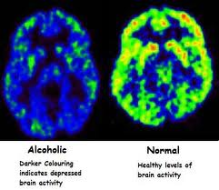

Slide 14
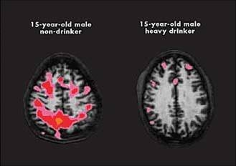

Slide 15
Teenagers and Alcohol
I. Drunken Driving
Among people up to age 34 in the U.S., motor vehicle accidents are the leading cause of death.
Approximately 1/3 of teenage deaths are the result of motor vehicle accidents.
There are things you can do to minimize your risk of getting involved in a drunken-driving accident.
Don’t drink.
Don’t accept a ride with anyone who has been drinking.
Show a parent the contract prepared by S.A.D.D. that guarantees that if called for a ride the parent will pick up their teenagers- no questions asked.

Slide 16
In what ways does problem drinking harm people?

Slide 17
Dr. Phil
https://www.youtube.com/watch?v=Q_0qniLXa-o
https://www.youtube.com/watch?v=Q_0qniLXa-o
https://www.youtube.com/watch?v=HSioK_yONQ4

Slide 18
Lesson 2: Choosing to live Alcohol-free
Psychological dependence
Condition in which a person believes that a drug is needed in order to feel good or to function normally.
Physiological dependence
A condition in which the user has a chemical need for the drug.

Slide 19
Stages of Alcoholism
Abuse
Addiction
Alcoholism- the state of being psychologically and physically addicted to alcohol. This is a disease like cancer or heart disease.

Slide 20
Abuse
I. Abuse
When a person who drinks alcohol can’t do so in moderation or at appropriate times
People who abuse alcohol regularly can suffer in many ways such as doing poorly in school or at their jobs.
Signs of alcohol abuse
Odor on the breath
Frequent absences
Intoxication
Loss of memory
Changes in peer-group associations and friendships.
Uncharacteristically passive or aggressive behavior.
Difficulty focusing, glazed eyes.
Decline in personal appearance or hygiene.

Slide 21
Addiction
III. Addiction
Eventually the dependence need will become a physical dependence.
Teenagers can become dependant in as little as 1 to 2 years. It takes most adults 5-20 years of alcohol abuse to become addicted.
Causes of Alcoholism
Children of alcoholics are more likely than others to become alcoholics as well.
Alcoholism probably results from a combination of psychological, environmental, and physical fear.

Slide 22
II. Dependence- People have a psychological need for alcohol to function properly.

Slide 23
How do each of the following factors influence alcohol use?
Peer pressure
Family
Media messages

Slide 24
Health Risks of Alcohol Use
Breaking the Law
Drinking under the age of 21 can lead to arrest, a fine, or even a criminal record.
Driving while under the influence of alcohol is illegal for people of all ages.
Alcohol and Violence
Alcohol and Sexual Activity
Alcohol and the Family - high risk for:
neglect, abuse or social isolation
economic hardship
personal use of alcohol use themselves
mental illness or physical problems
Alcohol and School – suspended or expelled

Slide 25
Losing Control
Losing Control
Teenagers who drink are more likely to engage in activities that conflict with their personal and parental values.
Teens who drink are twice as likely to contract an STD as teens who do not drink.
These actions can result in conflicts with family and friends, unwanted pregnancies, STD’s, etc …..
23 percent of sexually active teens use alcohol or other drugs before engaging in sexual activity.

Slide 26
DWI (Driving while intoxicate
BAC greater that .08 percent is drunk driving
Under 21, no acceptable BAC, since it’s illegal to use alcohol.
DUI (Driving under the influence

Slide 27
Standards Set by Parents of Guardians
An Alcohol- Free Life- some people choose not to drink because they like being sober.
Saying No Thanks
Saying No for Teens is often a matter of self-esteem.
There are many ways to say “no”, but in general, the less you make of it, the easier it’s going to be.

Slide 28
Fetal Alcohol Syndrome- a set of birth defects that can occur when a pregnant woman drinks alcohol. These defects include low birth weight, mental retardation, facial deformities, and behavioral problems.

Slide 29
Living with Fetal Alcohol Syndrome (FAS)
https://www.youtube.com/watch?v=vohBl7iRp3oLiving with Fetal Alcohol Syndrome (FAS)

Slide 30
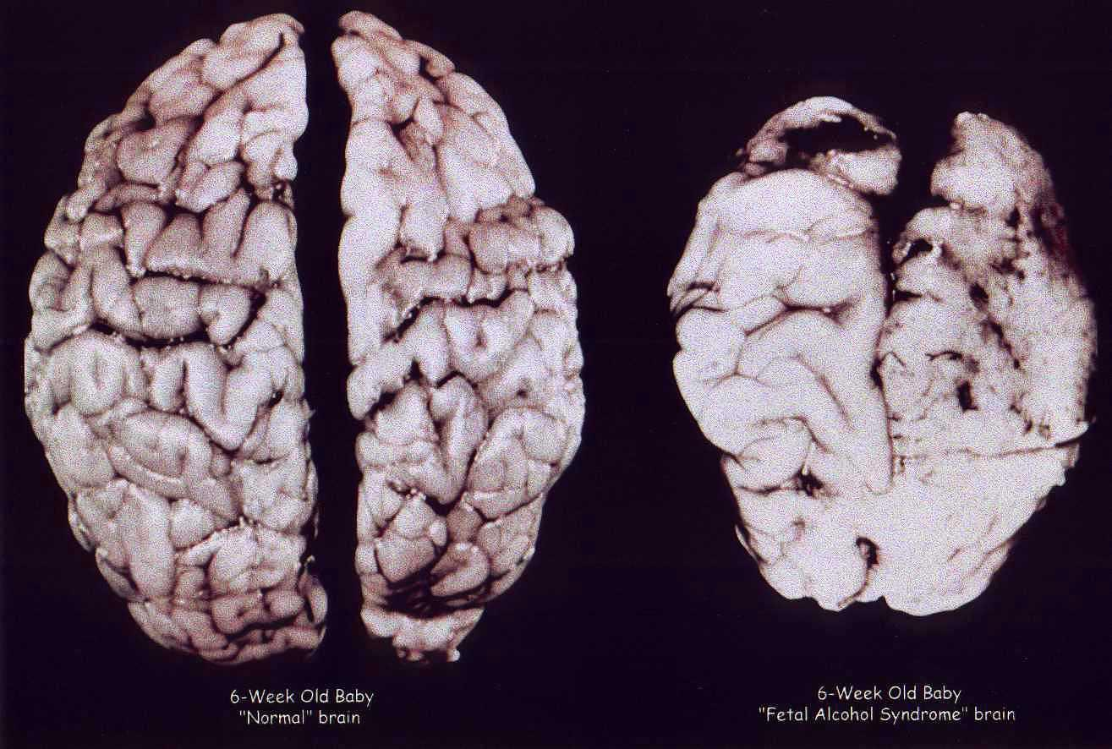

Slide 31
Alcohol and the Family
* 50-80% of all family violence involves alcohol.
* It is important to know that a parent’s drinking is not your fault and you can get help.

Slide 32
Alcohol and your brain
https://www.youtube.com/watch?v=zXjANz9r5F0

Slide 33
Lesson 3: The Impact of Alcohol Abuse
I. Withdrawal- the process of discontinuing a drug to which the body had become addicted.
* During withdrawal, a person may suffer extreme nervousness, headaches, tremors or seizures.
* The withdrawal phase of recovery usually lasts no more than a few days.

Slide 34
How can you encourage others to stay alcohol-free?

Slide 35
II. Inpatient and Outpatient Program
Some recovering alcoholics decide to join hospital inpatient programs, which mean they live at the hospital while receiving treatment.
Others choose to move home after completing withdrawal, and to participate in hospital outpatient programs.
Patients in both programs receive counseling in order to understand why they became addicted to alcohol and to help them cope with life without it.

Slide 36
III. Alcoholics Anonymous
This is the most widely used self-help program.
The AA method for recovery involves 12 steps. The first step is to recognize that they are powerless over alcohol.
Many attend AA meetings everyday.

Slide 37
IV. Al-Anon and Alateen – designed to help family members talk about the problems of living with an alcoholic.
Alateen is specifically designed to help teenagers cope with the same situation.
One of the most important goals of these groups is to help people realize that they can get help whether or not the alcoholic they are living with gets help.

