Slide 1
Chapter 3
Mental and Emotional Health
Developing your Self-Esteem & Developing Personal Identity & Character

Slide 2
Mental and Emotional Health
A Mentally Healthy Person Characteristics:
Sense of Belonging
Sense of Purpose
Positive Outlook
Self-sufficiency
Healthy self-esteem

Slide 3
Self-Esteem
1. When does it first begin to develop?
2. What can you do to improve your self-esteem?
3. What are the benefits of a healthy self-esteem?
4. How can you improve your self-esteem?

Slide 4
Ways to improve your self-esteem
Choose friends who value & respect you
Focus on positive aspects about yourself
Replace negative self-talk with supportive self-talk
Work toward accomplishments not perfection
Consider mistakes learning opportunities
Try new activities to discover your talents
Write down goals & the steps to achieve them
Exercise to feel more energized
Volunteer to help someone
Accept things you can’t change & focus energy on things you can change.

Slide 5
To prove that humans are not simply blindly reacting to situations, but trying to accomplish something greater, Maslow studied mentally healthy individuals instead of people with serious psychological issues. This informed his theory that people experience “peak experiences", high points in life when the individual is in harmony with himself and his surroundings. In Maslow's view, self-actualized people can have many peak experiences throughout a day while others have those experiences less frequently. ^{[3]}

Slide 6
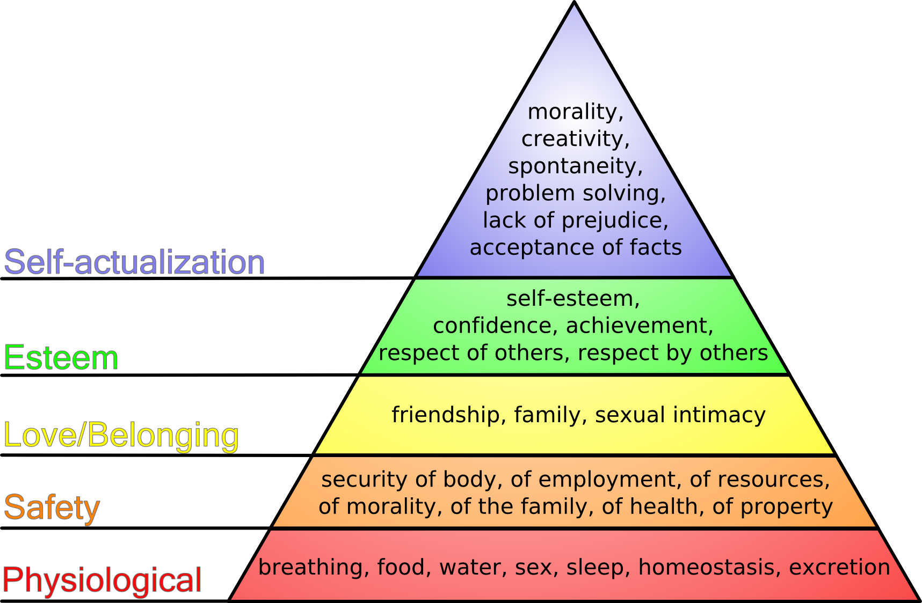

Slide 7
Are your Physiological Needs being met?
Did you eat?
Was it nutritious?
Did you get enough sleep?
Are you experiencing any physical pain?

Slide 8
Are your Safety and Security needs being met?
Do you feel safe right now?
Are you feeling threatened in any way?

Slide 9
Are your Love and Affection needs being met?
Explore your needs for love and affection.
Is there someone you would like to resolve a conflict with or need to spend time with?

Slide 10
Is your Self-Esteem needs being met?
Do you basically good about yourself and others?

Slide 11
How can you achieve Self-Actualization? (1%-2% of all people achieve)
Think about your talents and dreams.
Is there an activity that would make you feel more fulfilled?
Write down five things you can do to explore and develop your talents.
Realize that self-actualization is a process that continues throughout one’s lifetime.
Exploring talents and setting goals is one part of this process?

Slide 12
Lesson 2 – Developing Personal Identity & Character
Personal Identity – your sense of yourself as a unique individual
How does it form?
Relationships?
Experiences?

Slide 13
Importance of Good Character
What is Character
How does your character play a significant role in your decisions, actions, and behavior?

Slide 14
Traits of Good Character
Trustworthiness
Respect
Responsibility
Fairness
Caring
Citizenship

Slide 15
How do you develop a healthy identity? As a Group- explain how each of the following help to form a healthy identity.
Recognize your strengths & weaknesses
Demonstrate Positive Values
Develop a Purpose in Your Life
Form Meaningful Relationships
Avoid Unhealthful High-Risk Behaviors
Contribute to the Community

