Slide 1

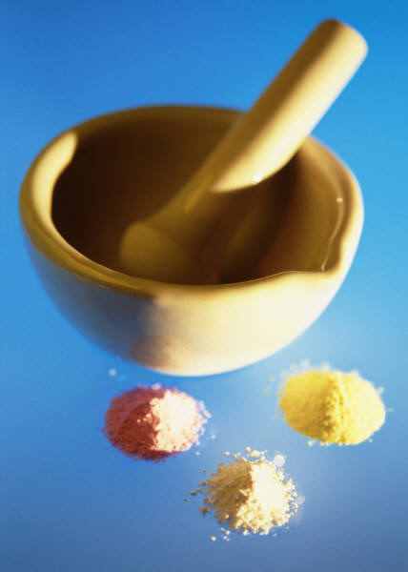
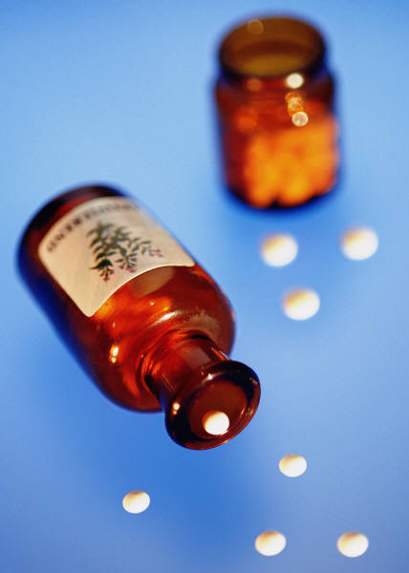
Ch. 19 Medicines and Drugs

Slide 2

Lesson 1 The Role of Medicines
Discussion question: Do we live in a medicated society as Americans? Explain.
What percentage of Americans are drug users?

Slide 3
Medicines are classified by how they work in your body
Drugs- substances other than food that change the structure or function of the body or mind
Medicines- drugs that are used to treat of prevent diseases or other conditions
Why do people take drugs? (Purpose)
    Help prevent disease
    Fight pathogens
    Relieve pain and other symptoms
    Regulate body’s systems/manage chronic conditions/maintain or restore health

Slide 4
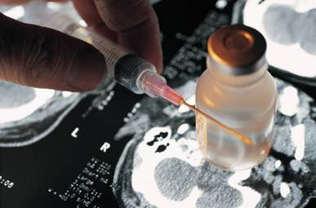
Preventing Disease:
Vaccines- a preparation that prevents a person from contracting a specific disease
Antitoxins- fight the bacteria that produce substances toxic in the body
Fighting Pathogens:
Antibiotics- destroys disease-causing microorganisms (bacteria)
Antivirals and Antifungals- suppress viruses (colds, fever blisters, etc.) and fungi (ringworm, or athletes foot)
Analgesics- used to relieve pain and inflammation

Slide 5
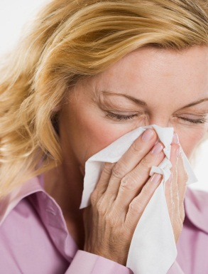
Chronic Conditions:
Allergy medicines- antihistamines reduce allergy symptoms (sneezing, itching, and watery eyes)
Body Regulating Medicines- regulate body chemistry (insulin)

Slide 6

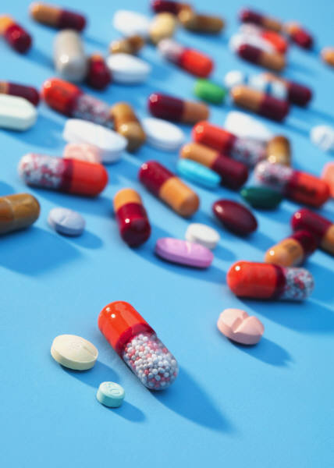
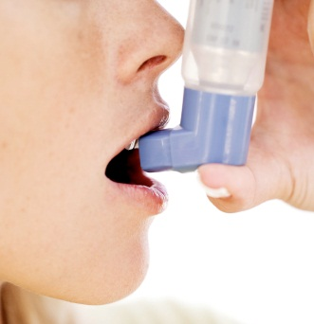
Antidepressant: help
individuals from mental
illnesses (brain chemistry, moods)
How we take Medicines:
Oral
Topical
Inhaled
Injected

Slide 7
Reactions to Medicines
Side effect- reaction to medicine other than the one intended
Additive interaction- medicines work together in a positive way (anti-inflammatory and a muscle relaxer to treat joint pain)
Synergistic effect- the interaction of two or more medicines that result in a greater effect than when each medicine is taken alone
Antagonistic interaction- one medicine is canceled or reduced when taken with another medicine

Slide 8
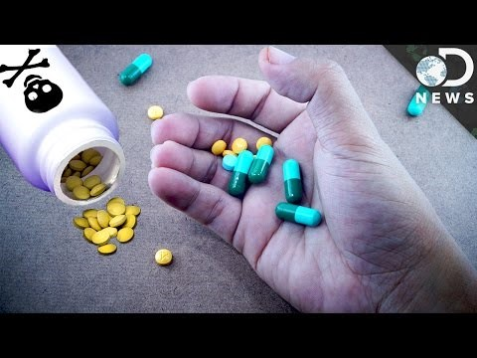
Drug Interactions

Slide 9
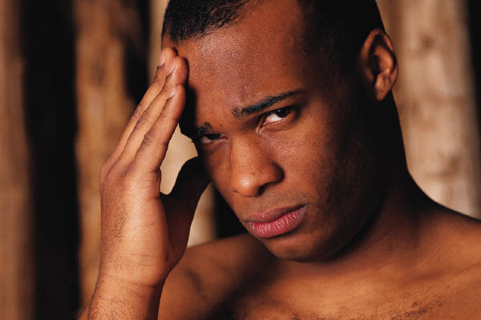
Tolerance- a condition in which the body becomes used to the effect of a medicine. The body requires increasingly larger doses to produce the same effect.
Withdrawal- someone stops using a medicine on which he/she becomes physiologically dependent.
  Symptom:
    Nervousness, insomnia, severe headaches, vomiting, chills, and cramps

Slide 10
Lesson 2: Using Medicines Safely
List as many drugs as you can:
Prescriptions | OTC’s

Slide 11
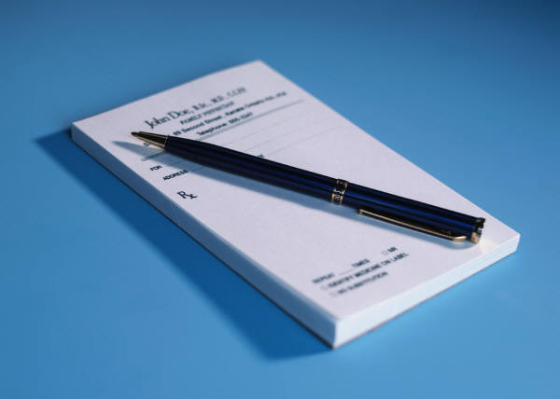
Prescription - medicines that are dispensed only with the written approval of a licensed physician
Over the counter (OTC)- you can buy without a doctor’s prescription

Slide 12
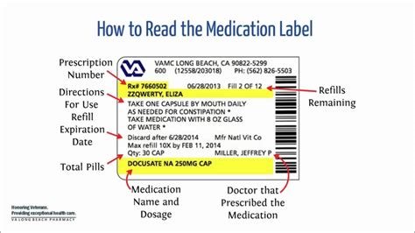
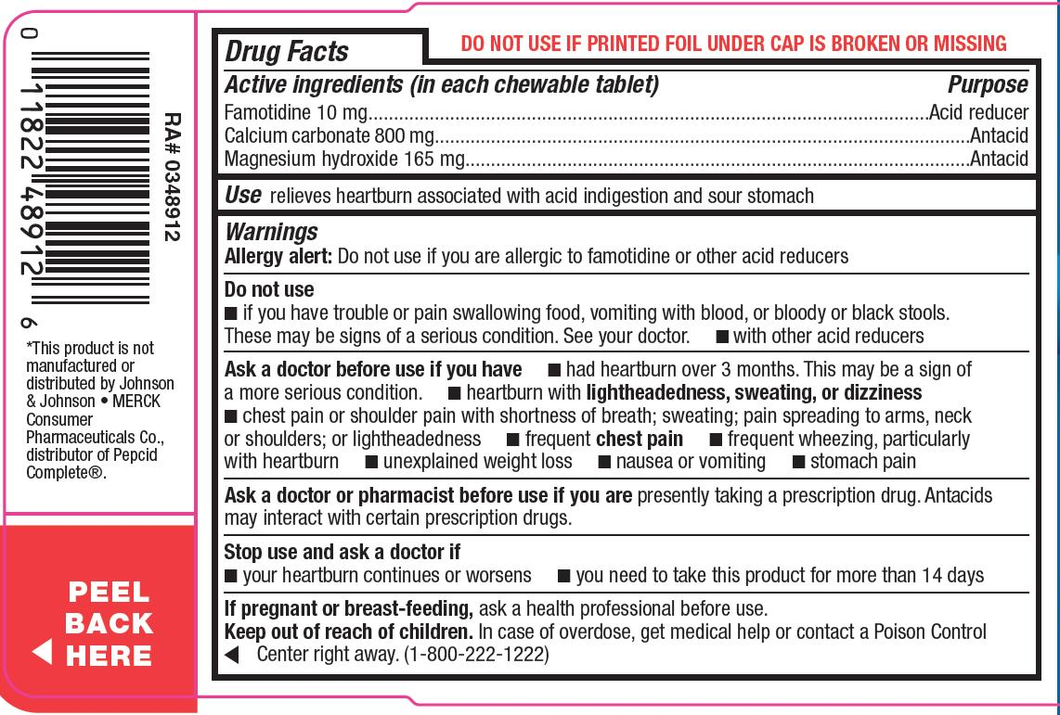
How to read a prescription label vs. OTC label
Over the Counter Label- have to be approved by the FDA so that the drug is considered to be safe enough of everyone
Prescription Label

Slide 13
Medicine Misuse: using a medicine in ways other than the intended one
  Failing to follow the instructions
  Giving a prescription medicine to another person
  Taking too much or too little of a medicine
  Taking a medicine for a longer or shorter period of time than the one recommended
  Discontinuing use of a medicine without the doctor’s knowledge
  Mixing medicines

Slide 14
Medicine Abuse: intentionally taking medications for nonmedical reasons
Teens should avoid using drugs to:
  To lose weight or stay awake
  To fit in with peers (pill parties- mixing as many OTC medicines as you can and taking them all at once to see the effects)
  Avoid taking medicines that were prescribed to someone else

Slide 15
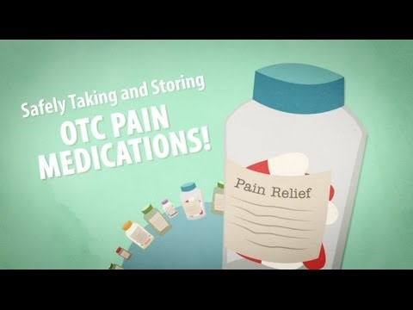
Taking OTC’s Safely

Slide 16
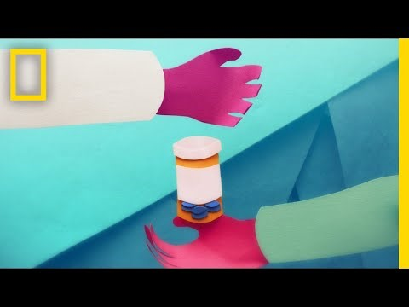
What happens when we take Opioids?

Slide 17
Growing Danger of mixing Prescription Drugs and supplements
http://www.cnn.com/2016/03/21/health/dangers-mixing-prescription-drugs-supplements/index.html

Slide 18
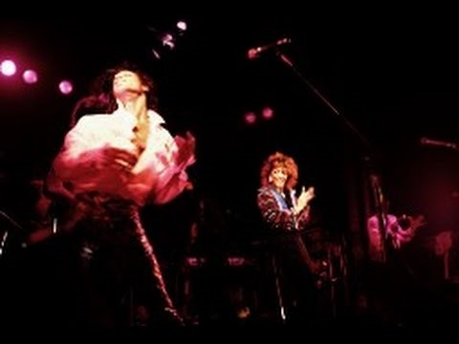
Prince dies from Accidental Overdose

Slide 19
Create a Drug – Partner Assignment
What type of medicine are you creating? ___________________________
Ailment
5pts __________
Name of Medicine
5pts __________
Label information (1
pt
each item
below
)
7
pts _________
Name and statement of product
What
the
product will do
Quantity of product
Active ingredients
Name of manufacturer
Correct a
mount of each dose
How to store
Description of how the medicine will help
5
pts _________
Package design
5
pts _________

